Slide 1
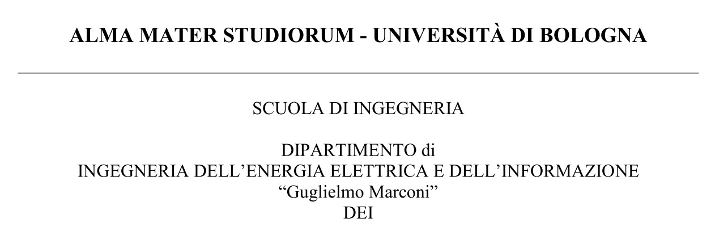
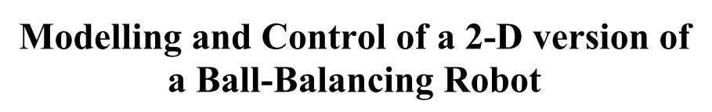

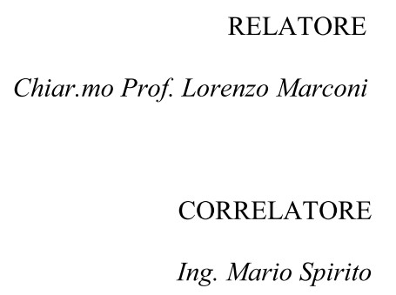
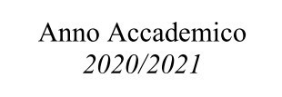

Slide 2
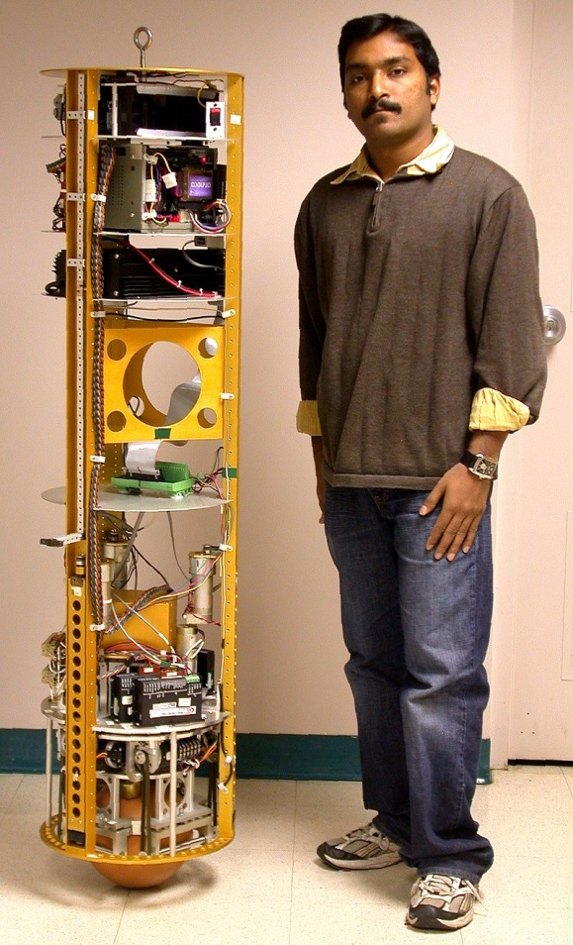
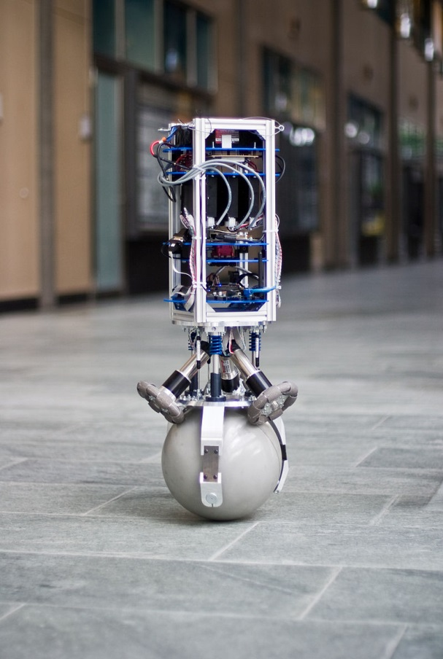
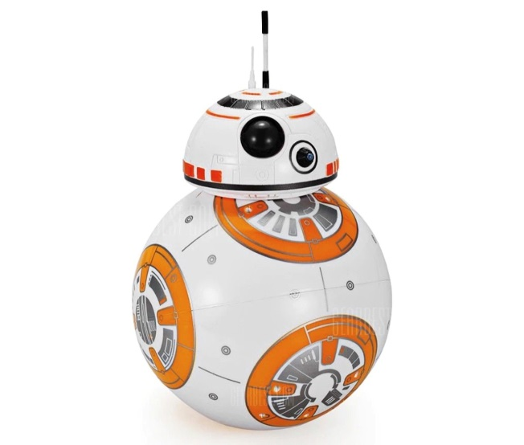
Ball-Balancing Robot
Droid BB-8, from the Star Wars cinematic universe
The first Ball-Balancing Robot built at Carnegie Mellon University, USA in 2005
A later version of ball-Balancing Robot built at ETH Zurich, Switzerland in 2010

Slide 3
Thesis Structure
Modelling
Fixed Axes
Moving Axes
Control
Fixed Axes
Moving Axes
Future development

Slide 4
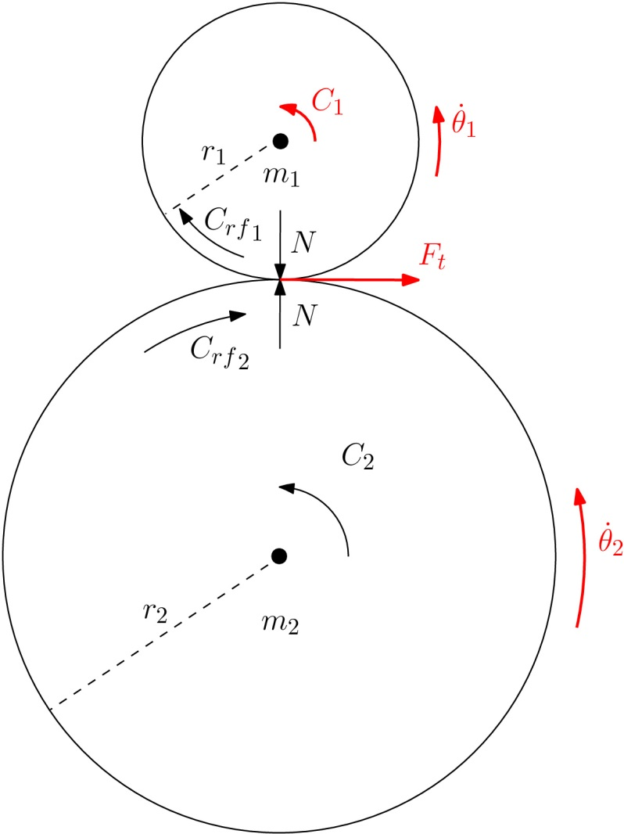
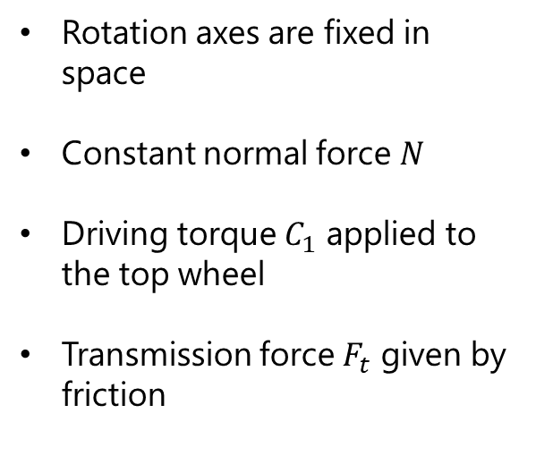
Modelling - Fixed Axes
Study of the contact dynamics
Rotation axes are fixed in space
Constant normal force $N$
Driving torque $C_{1}$ applied to the top wheel
Transmission force $F_{t}$ given by friction

Slide 5
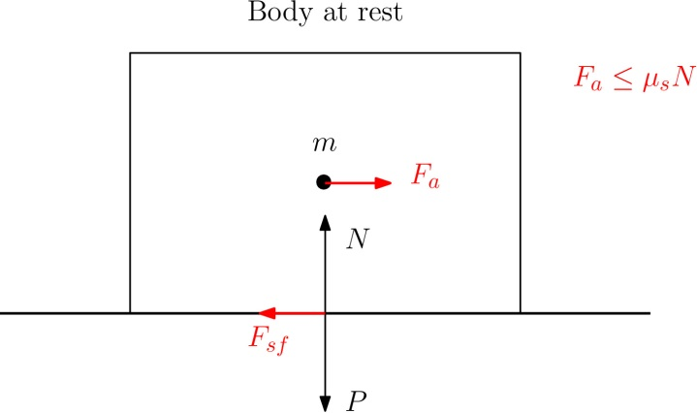
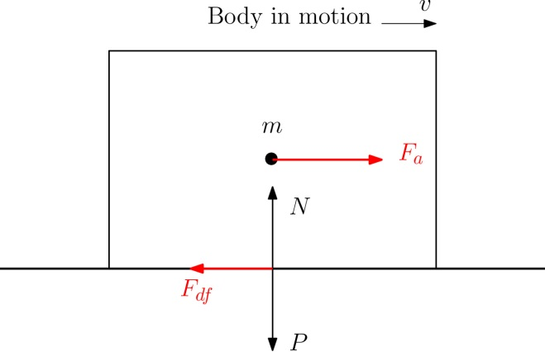
Modelling - Fixed Axes
Plane scenario
Rolling scenario
Pure rolling
Rolling with sliding

Slide 6
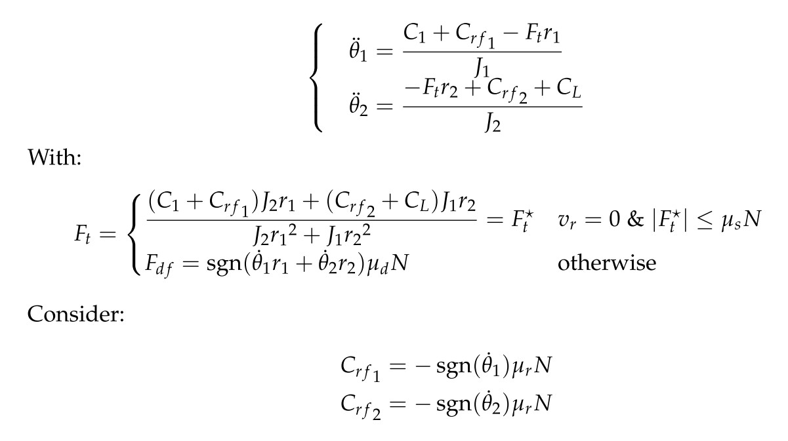
Modelling - Fixed Axes
Final equations of the system

Slide 7
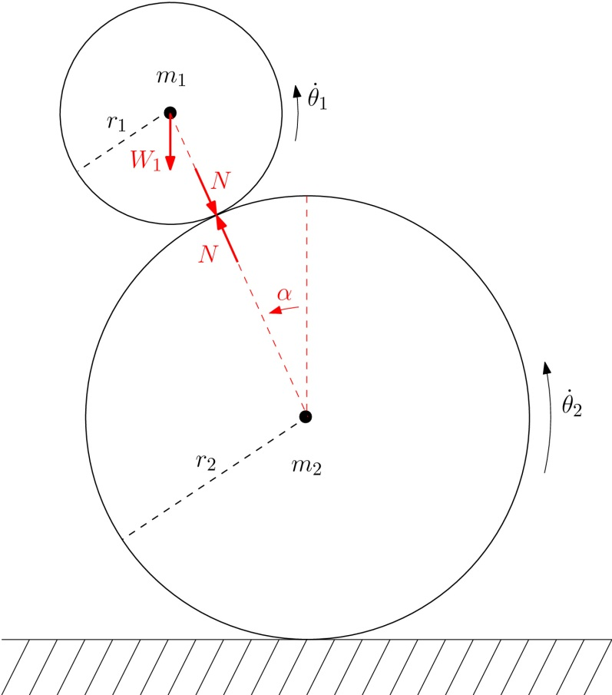
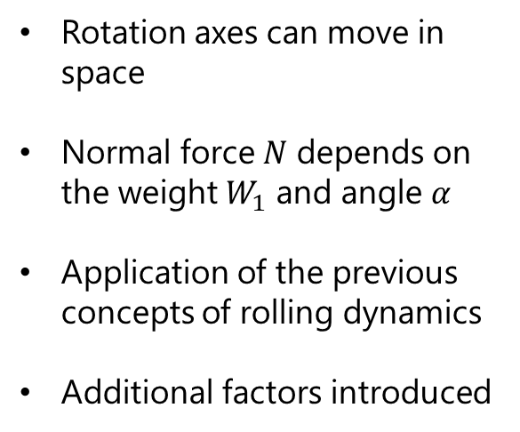
Modelling - Moving Axes
Study of the system in space
Rotation axes can move in space
Normal force $N$ depends on the weight $W_{1}$ and angle $α$
Application of the previous concepts of rolling dynamics
Additional factors introduced

Slide 8
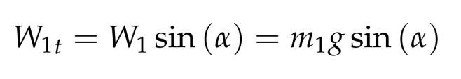
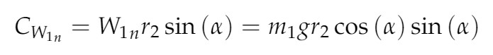
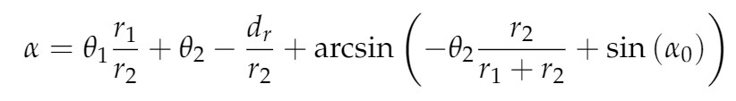
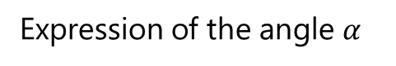
Modelling - Moving Axes
Additional factors
Tangential component of the weight on the contact point
Torque generated by the normal component of the weight on the contact point with the ground
Expression of the angle $α$

Slide 9
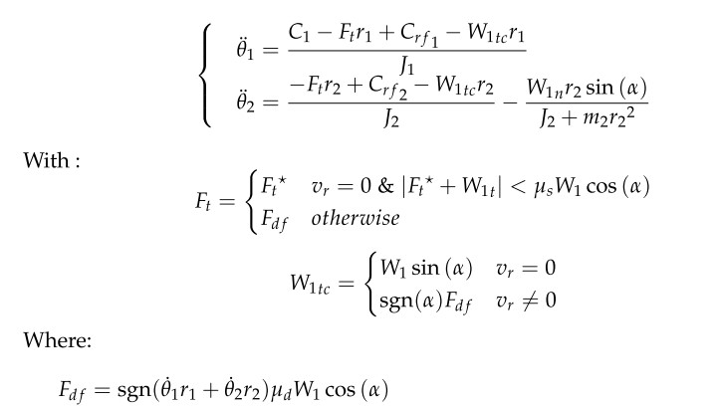
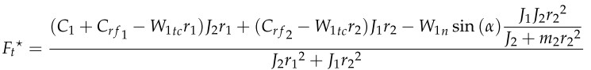
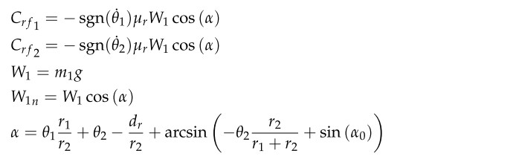
Modelling - Moving Axes
Final equations of the system

Slide 10
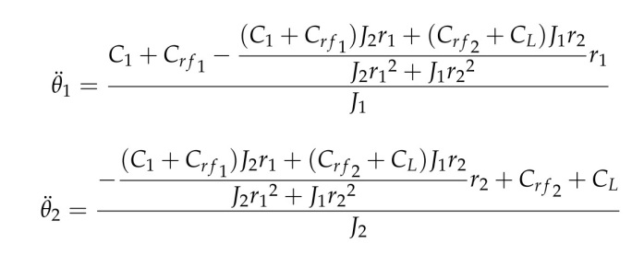
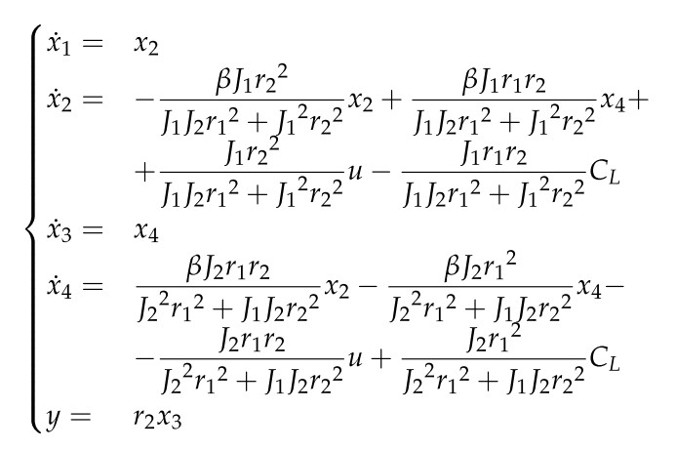
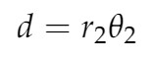
Control - Fixed Axes
Dynamics equations
Final state-space representation
Output
Considered states and input

Slide 11
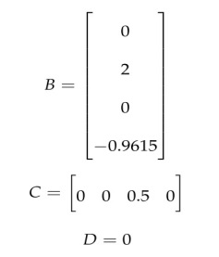
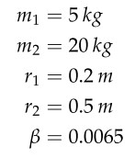
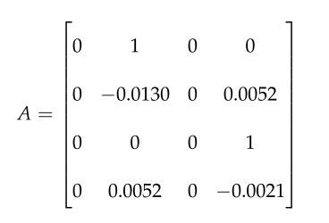
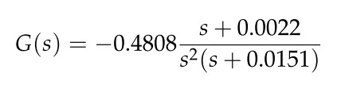
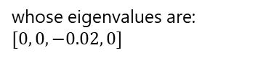
Control - Fixed Axes
B, C and D matrices
Arbitrary values
A matrix
Transfer function for the system
whose eigenvalues are:
$$[0, 0, −0.02, 0]$$

Slide 12
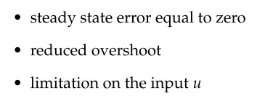
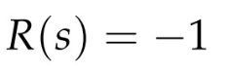
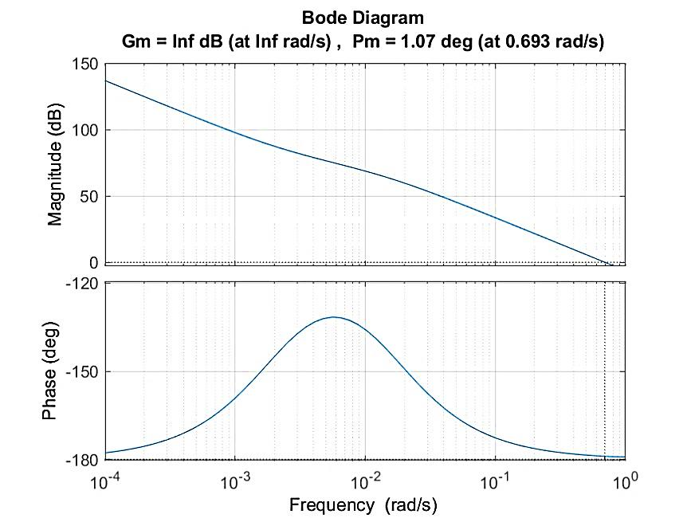
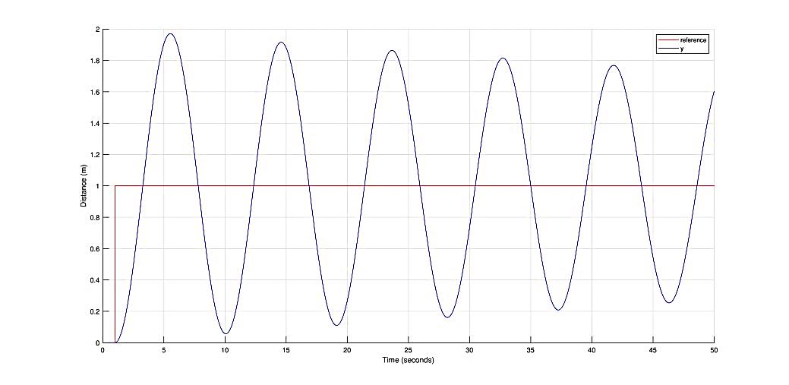
Control - Fixed Axes
Conditions
Regulator
Bode diagram
Step response

Slide 13
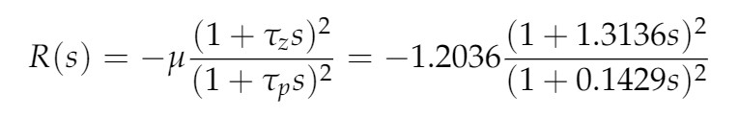
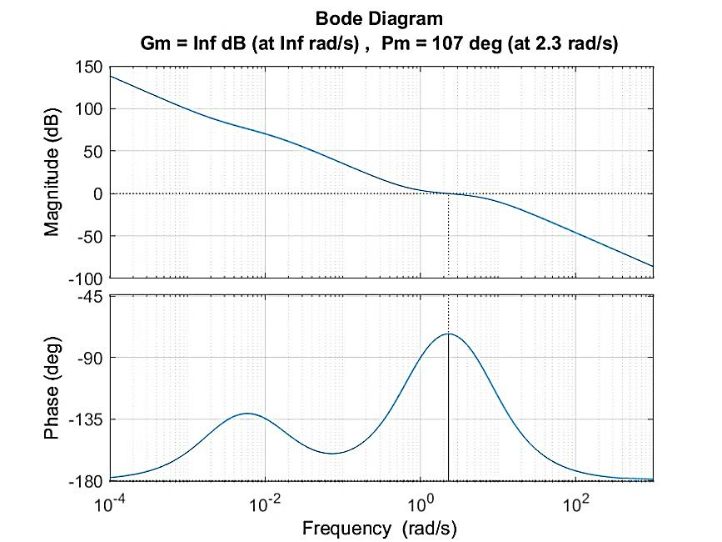
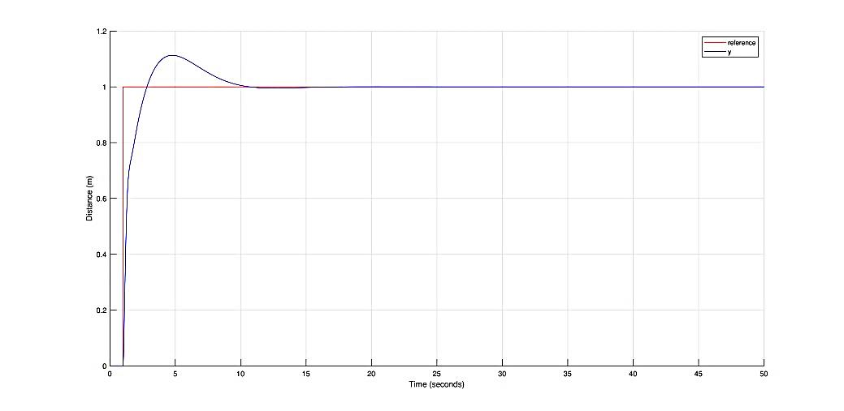
Control - Fixed Axes
Goal
Regulator
Increase phase margin with an anticipatory network
Bode diagram
Step response

Slide 14
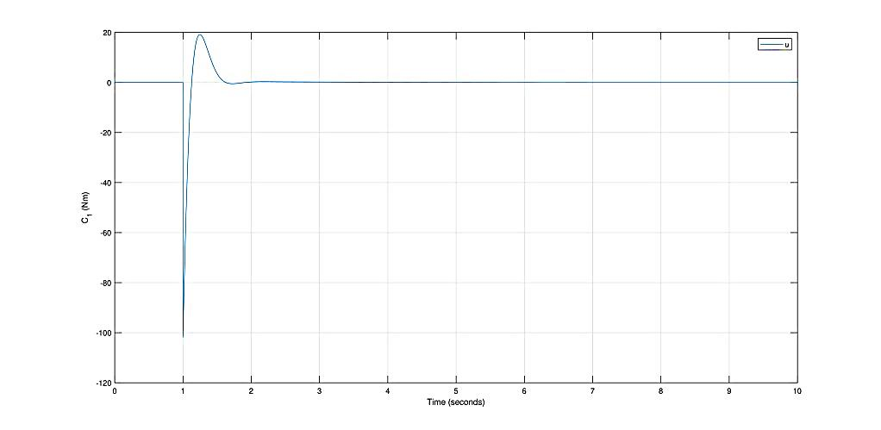
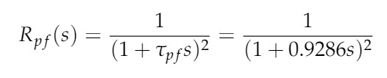
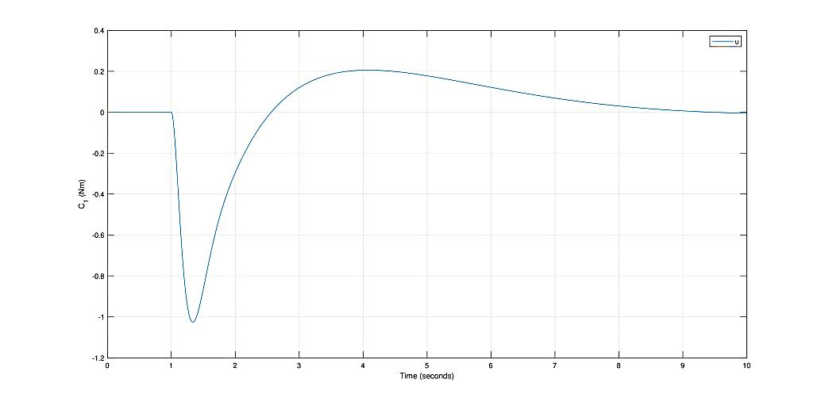
Control - Fixed Axes
Prefilter
Control input
Regulator
New control input
Goal
Reduce the control input with a prefilter

Slide 15
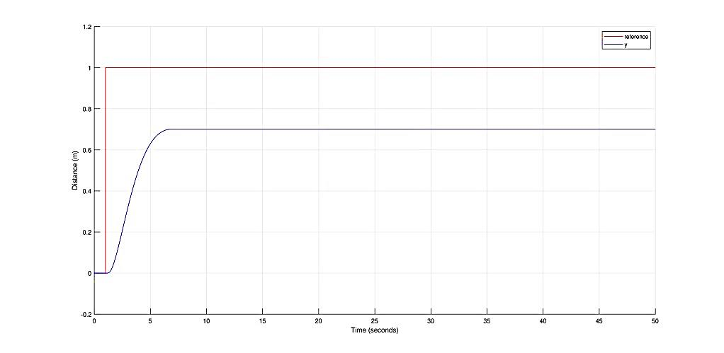
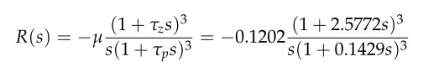
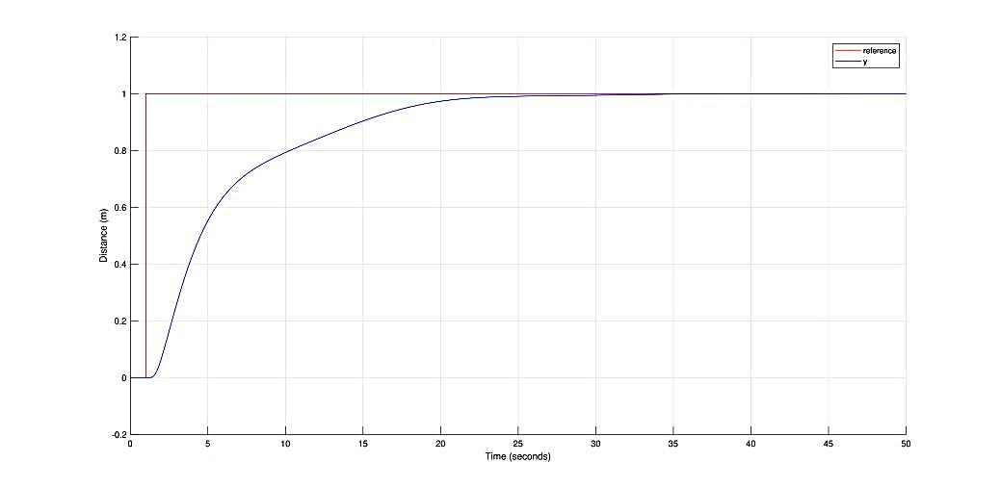
Control - Fixed Axes
Real system
Step response of the real system
Regulator
New step response of the real system
Goal
Bring steady state error to zero with an integrator

Slide 16
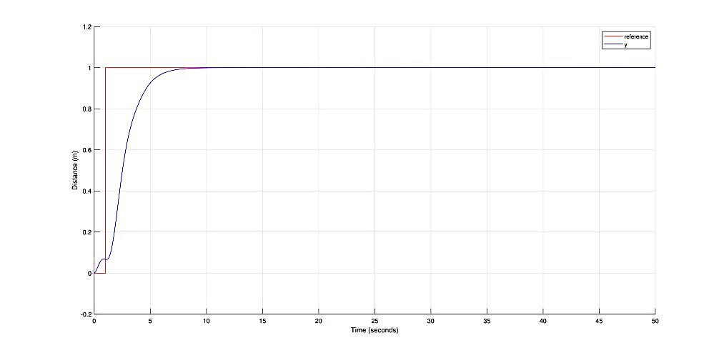
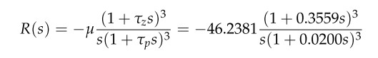
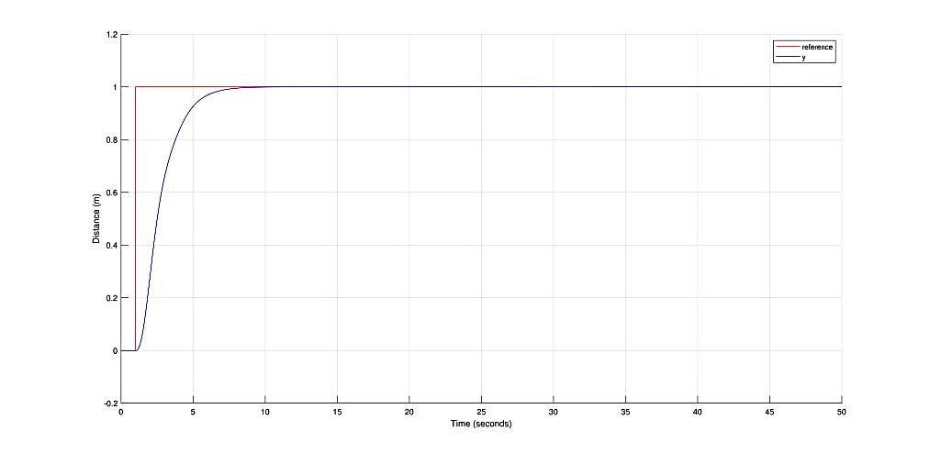
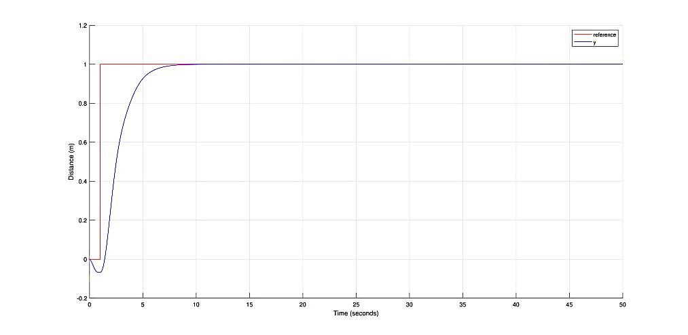
Control - Fixed Axes
Real system
Positive and negative loads
Shift zeros to higher frequencies to reduce settling tail
Regulator
No load

Slide 17
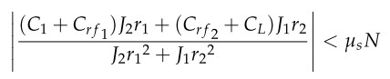
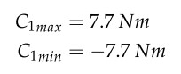
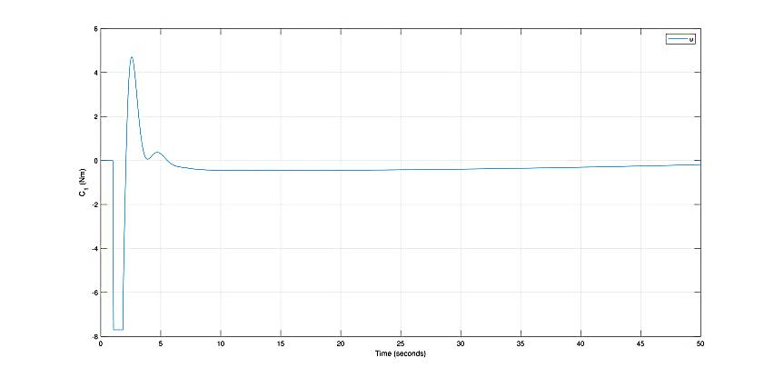
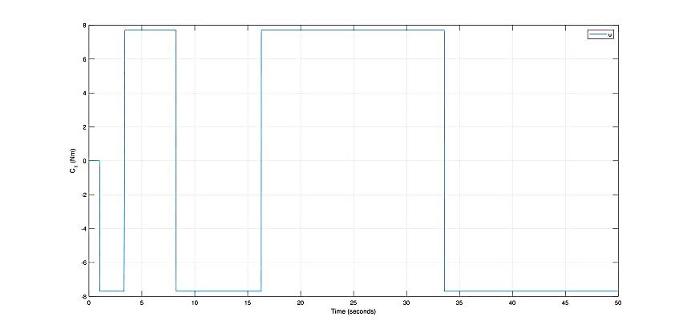


Control - Fixed Axes
Saturation
Initial step: 5m
Initial step: 10m

Slide 18





Control - Fixed Axes
Anti-windup network
Goal
Initial step: 10m
Erase the windup for high input step
Polynomial
Regulators

Slide 19

Control - Fixed Axes
Complete Simulink control scheme

Slide 20

Control - Fixed Axes

Slide 21



Control - Moving Axes
Final state-space representation
Dynamics equations
Outputs
Considered states and input

Slide 22






Control - Moving Axes
Linearization of the system for $\overline{x}=\left[0,0,0,0\right]$ and $\overline{u}=[0]$
B, C and D matrices
Arbitrary values
A matrix
Transfer matrix for the system
whose eigenvalues are:
$$[−1.33,+1.32, −0.01, −0.01]$$

Slide 23



Control - Moving Axes
System instability
A matrix eigenvalues
Outputs of the system for ${θ_{1}}_{0}=\frac{π}{10}$

Slide 24






Control - Moving Axes
Pole Placement
Attempt 1
Attempt 2
Outputs of the system
Outputs of the system

Slide 25





Control - Moving Axes
LQR
Value of $α$ for $Q=diag(1)$

Slide 26






Control - Moving Axes
Real system
Value of $α$ for $Q=diag(1)$
Value of $α$ for $Q=diag({10}^{3})$

Slide 27




Control - Moving Axes
Control input
Control input for ${θ_{1}}_{0}=\frac{π}{10}$
Control input for ${θ_{1}}_{0}=\frac{π}{3}$

Slide 28






Control - Moving Axes
Saturation
Control input for ${θ_{1}}_{0}=\frac{π}{3}$
Value of $α$ for ${θ_{1}}_{0}=\frac{π}{3}$

Slide 29






Control - Moving Axes
Compensation of steady-state error
Attempt 1
Attempt 2
Value of $α$ with simple integrator
Value of $α$ with integrator and gain

Slide 30

Control - Moving Axes
Complete Simulink control scheme

Slide 31

Control - Moving Axes

Slide 32
Future developments
Optimization
Carter’s analysis on micro slip
Rolling with sliding with the ground
Add more frictions
Optimization of the controllers
Expansion
Addition of an inverted pendulum
Modelling of the motor
Combination of the two controls
Expansion to the 3-D case

Slide 33
May the torque be with you

